Slide 1
Cloud Strategy Migration Nykaa E Retail Pvt Ltd Project Kick-off
24-June-2022

Slide 2
Agenda
Topic | Details
Project Teams | Introduce project team
Project Objectives | Review project objectives
Hanu E2E Migration Approach | Overview of the end-to-end migration approach
Migration Strategy | Migration approach ( Sync File server)
Project Governance Model | Project governance
Escalation Matrix | Draft of high-level project milestones
Reporting Structure | Project Status Reporting Structure

Slide 3
Sandeep Nanchahal | sandeep.nanchahal@nykaa.com
Project Team – Hanu & Nykaa E Retail Pvt Ltd
Hanu Team
CSR
Lalit Vashisht | Presales Specialist
Sitarama Prakki | Project Manager
Dhawal Baranwal | Cloud Solution Specialist
Sahej Singh Bhatia | Senior Cloud Engineer
Md Saqlin Mushtaq | Cloud Engineer
Sidharth Deokuliar | Cloud Engineer
Nykaa E Retail Pvt Ltd Team

Slide 4
Project Objective
Foundational Services
Onboarding
Azure File Sync and AD User Sync
Setting up Azure File Share with Active Directory Authentication
Identity and Access Management
Networking
Security
Testing
Landing Zone setup and Minimum Viable Cloud
Governance
Automation
DNS Server & Azure Active Directory Setup

Slide 5
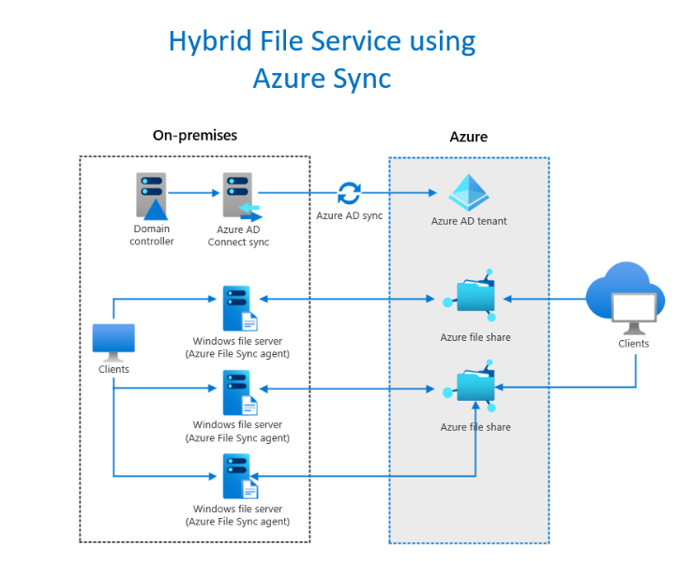
Proposed architecture

Slide 6
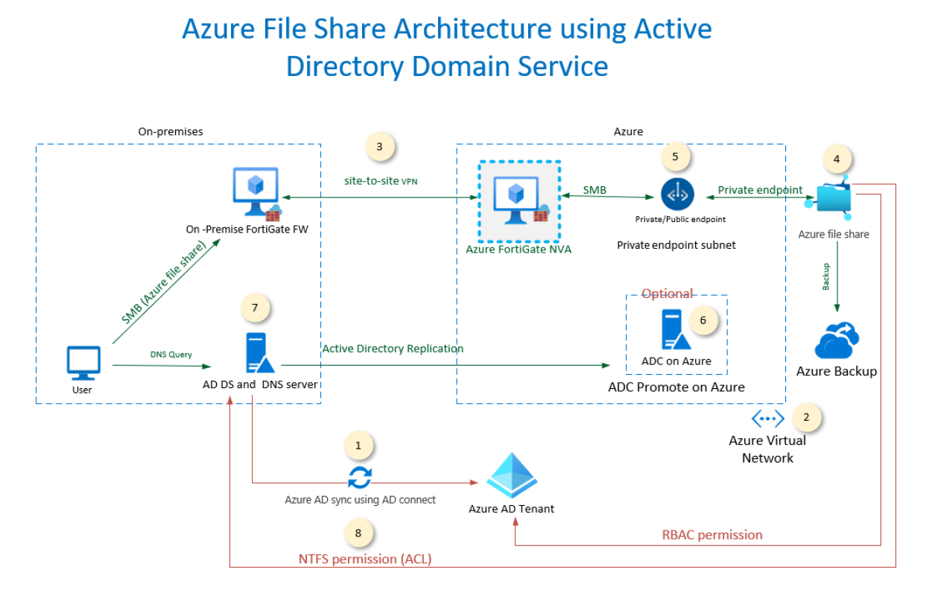
Proposed architecture for Az file Sync with ADDS

Slide 7
Hanu Azure File Sync and AD User Sync Approach
Foundational Services & IAM
Hanu Team will be creating a new Subscription under existing D365 Tenant of Nykaa Fashion
Role Based Access Control (RBAC) definitions
Azure AD Setup
Defining Resource Groups
DNS Server & Azure Active Directory Setup
Promote DNS Server only, on Azure VM
User to be created with.onmicrosoft.com identity on Azure
Install Azure AD connect on the on-premises Server
Sync the User’s group to Azure Active directory using soft match for 10 User’s
Prepare networking
Creation of FortiGate NVA
Creation of Site-to-Site VPN from on-premises to Azure between 3-4 location
Create Network Security Groups
Setting up Azure File Share with Active Directory
Create an Azure File Share
Enable Active Directory Authentication with Azure Storage Account
Assign RBAC to the Specified User’s
Assign ACL permission to the User’s Group
Create DNS Zone /forwarder on Active Directory
Setting up Azure File Sync Service between On Premises file Server to Azure File Shar
Install the Azure File Sync agent on the On-premises file server
Register the on-premises server with Azure file Sync
Sync the Data from on-premises to Azure File Share 500 GB
Once the Data are synced to Azure, remove the Server Endpoint

Slide 8
Overview
Hanu’s Landing Zone focuses on setting up the basics after evaluating client’s infrastructure to ensure its readiness for workload migrations
Identity & Access Management
Connectivity & Network Design
Azure Security
Azure Governance
Automation
Onboarding
CSP Azure Onboarding, Account and Subscription Setup
Authentication & Authorization, Role Based Access
Connectivity between Azure and Physical Offices/Data Centers
Implementing Azure Security leveraging native and 3rd Party tools
Turn on cost optimized monitoring and Setup Policies for Azure infrastructure
Assist in automating the repetitive jobs, tasks and deployments
Notes:
OMS -
SCOM – Performance/health monitoring system for Win/Unix. OnPrem product to monitor datacenter environment. It can also be extended to monitor Azure resources too. For example, SCOM has a Management Pack (MP) that enables you to monitor the availability and performance of your ARM based resources that are running in Azure.
Azure Security Center (ASC)
Azure Advisor
Azure Alerts
Azure Diagnostics
Azure Metrics
Azure Monitor
Activity Logs
Application Insights
Network Watcher
Service Health

Slide 9
Project Governance Model – Overview
Weekly Management Committee
Agenda
Review Project Status (RAG) Review RAID Log Resolution of project escalations
Purpose | Frequency
Resolution of project risks, issues and escalations | Weekly
Nykaa E Retail Pvt Ltd
Sandeep Nanchahal
Hanu
Pushpesh Joshi
Dhawal \ Sahej\Saqlin\Sidharth
Satya
Lalit Vashisht ( Optional)

Slide 10
Project Governance Model – Escalation Process
Escalation Level | Hanu
Level One | Pushpesh Joshi| Pushpesh.Joshi@hanu.com | Tech. PM | M: +91- 7042828086 |
Level Two | Satya Dantuluri| Satyad@hanu.com |Delivery Head| M: +1 (732) 689-1199 |
Escalation Level | Nykaa Fashion
Level One | |
Level Two | |
Level Three | |

Slide 11
Project Status Report
Weekly Status Report Structure
Project summary and key indicators (number of risks, issues, action items, dependencies, and decisions)
Key Milestones / Deliverables and Status
# | Phases, Tasks, Deliverables, Milestones | Due Date | Assigned | Status | % Done | Comments
Issues, Risks, or Concerns
No. | Source | Issue / Risk | Description | Impact | Mitigation | Owner | Date Opened | Due Date | Status | Comments
Action Items
Action No. | Source | Actions | Owner | Date Opened | Due Date | Revised Date | Status | Comments
Dependencies
Dependency No. | Source | Dependency | Task/SubTask Blocked | Open Date | Target Unblock Date | Owner | Status | Comments
Decisions
Decision No. | Source | Decision | Decision Date | Decision By | Comments

Slide 12


